Slide 1
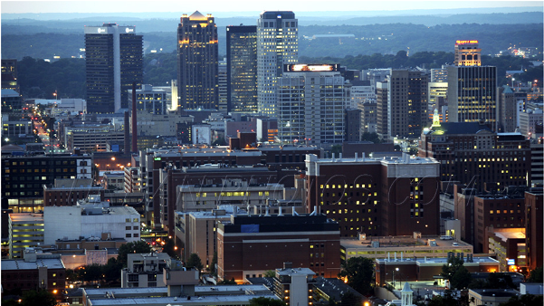
BIRMINGHAM City of England

Slide 2
In a nutshell
- Area: 267.77 km²
- Population: about 1,016,800
- Language: english
- Time zone: Greenwich Mean Time (UTC+0)
- Elevation: 140 m
- Density: 3,739/km²
- www.birmingham.gov.uk

Slide 3
History
In the early 7th century , Birmingham was an Anglo-Saxon farming hamlet on the banks of the River Rea.
In 1166 the holder of the manor of Birmingham, Peter de Birmingham, was granted a royal charter to hold a market in his castle, which in time became known as the Bull Ring, transforming Birmingham from a village to a market town
As early as the 16th century, Birmingham's access to supplies of iron ore and coal meant that metalworking industries became established.

Slide 4
Economy
Although Birmingham grew to prominence as a manufacturing and engineering centre, its economy today is dominated by the service sector, which in 2003 accounted for 78% of the city's economic output and 97% of its economic growth.
Tourism is also an increasingly important part of the local economy.
The city's three Universities, (Aston University, University of Birmingham and Birmingham City University)

Slide 5
Geography
Birmingham is located in the centre of the West Midlands region of England on the Birmingham Plateau – an area of relatively high ground, ranging around 500 to 1,000 feet (150–300 m) above sea level and crossed by Britain's main north-south watershed between the basins of the Rivers Severn and Trent.

Slide 6
Sports
The Football League – the world's first league football competition – was founded by Birmingham resident and Aston Villa director William McGregor
The Birmingham and District Cricket League is the oldest cricket league in the world
The modern game of tennis was developed between 1859 and 1865 by Harry Gem and his friend Augurio Perera

Slide 7
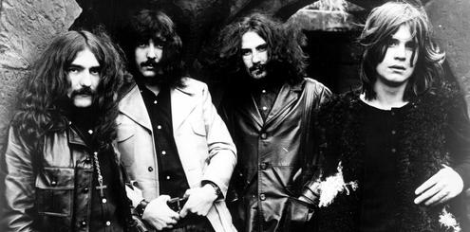
Music
Birmingham has had a vibrant and varied musical history over the last century.
The city is often described as the birthplace of heavy metal music,with Judas Priest, Black Sabbath, Magnum and two members of Led Zeppelin being local.

Slide 8
THUIN
BELGIUM

Slide 9
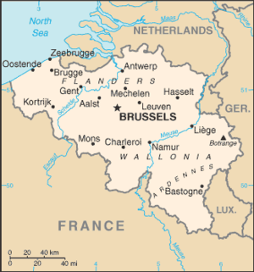
BELGIUM
Capital: Bryssel
Population: 10 161 000
Language: Dutch, German, French
Religion: Catholic Christianity

Slide 10
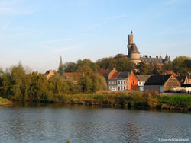
Geography
There is three different areas in Belgium.
There is plain and sand dunes on the coast.
The central plateau is flat, fertile land.
There is forest and mountains in southeast.

Slide 11
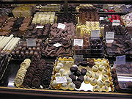
Culture
Sport: The most popular sports are football and cycling.
Music: Belgian Adolphe Sax invented the saxophone in 1846.
Food: Waffles and French fries are originally from Belgium. Belgium is also renowned for chocolate and strong beer.

Slide 12
Varna Bulgaria

Slide 13
Varna Bulgaria
Location
Seaside resort on the Bulgarian Black Sea Coast and in Northern Bulgaria
Geography
The city occupies 205 km² (79 sq mi) on verdant terraces (Varna monocline of the Moesian platform) descending from the calcareous Franga Plateau (height 356 m/1,168 ft) on the north and Avren Plateau on the south, along the horseshoe-shaped Varna Bay of the Black Sea, the elongated Lake Varna, and two artificial waterways connecting the bay and the lake and bridged by the Asparuhov most.
The urban area has in excess of 20 km (12 mi) of sand beaches and abounds in thermal mineral water sources (temperature 35–55 °C / 95–131 °F). It enjoys a mild continental climate influenced by the sea with long, mild, akin to Mediterranean, autumns, and sunny and hot yet considerably cooler than Mediterranean summers moderated by a breeze and more regular rainfall.

Slide 14
Population
Varna is one of the few cities in Bulgaria with a positive natural growth (6300 births vs. 3600 deaths in 2009) and new children's day care centers opening (6 expected in 2009). n 2008, Deputy Mayor Venelin Zhechev estimated the actual population at 650,000. In December 2008, Mayor Kiril Yordanov claimed the actual number of permanent residents was 970,000, or that there were 60% unregistered people. In January 2009, the Financial Times said that "Varna now draws about 30,000 new residents a year.“
History
Battle of Varna
On 10 November 1444, one of the last major battles of the Crusades in European history was fought outside the city walls. The Turks routed an army of 20,000 crusaders led by Ladislaus III of Poland (also Ulászló I of Hungary), which had assembled at the port to set sail to Constantinople. The Christian army was attacked by a superior force of 55,000 or 60,000 Ottomans led by sultan Murad II.

Slide 15
Late Ottoman rule
A major port, agricultural, trade and shipbuilding centre for the Ottoman Empire in the 16th-17th century, preserving a significant and economically active Bulgarian population, Varna was later made one of the Quadrilateral Fortresses (along with Rousse, Shumen, and Silistra) severing Dobruja from the rest of Bulgaria and containing Russia in the Russo-Turkish wars. The Russians temporarily took over in 1773 and again in 1828, following the prolonged Siege of Varna, returning it to the Ottomans two years later after the medieval fortress was razed.
Economy
Varna is the second most important economic centre for Bulgaria after Sofia, the country's foremost trade link to Russia, and one of the major hubs for the Black Sea region. The economy is service-based, with 61% of net revenue generated in trade and tourism, 16% in manufacturing, 14% in transportation and communications, and 6% in construction. Financial services, particularly banking, insurance, investment management, and real-estate finance are booming.

Slide 16
Sights
City landmarks include the Varna Archaeological Museum, exhibiting the Gold of Varna, the Roman Baths, the Battle of Varna Park Museum, the Naval Museum in the Italianate Villa Assareto displaying the museum ship Drazki torpedo boat, the Museum of Ethnography in an Ottoman-period compound featuring the life of local urban dwellers, fisherfolk, and peasants in the late 19th and early 20th century.

Slide 17
Szczecin Poland

Slide 18
Szczecin

Slide 19
Finance
Poland is the only member of the European Union to have avoided a decline in GDP, meaning that in 2009 Poland has created the most GDP growth in the EU. December 2009 the Polish economy had not entered recession nor even contracted, while its IMF 2010 GDP growth forecast of 1.9 per cent is expected to be upgraded.
Poland is the 6th biggest economy in the EU and is considered to currently have one of the fastest growing economies in Central European nations, with an annual growth rate of over 6.0% before the late-2000s recession. Poland has steadfastly pursued a policy of economic liberalization throughout the 1990s, with positive results for economic growth but negative results for some sectors of the population. Poland`s sales turnover has growth at last couple years and in 2008 worth was almost threefold compared to year 2000.

Slide 20
Nature and geography of Szczecin
The town of Szczecin is located in shore of Oderinhaff in north-western Poland
Size of Szczecin is 301 km²
It is seventh largest town in Poland
Population of Szczecin is 407 000
Locates in the region of West Pomeranian voivod

Slide 21
Climate of Szczecin
There is temperate climate and weather is usually rainy and cool.
Four seasons, winter, spring, summer, autumn.
Environment of Szczecin is about one meter above sea level.

Slide 22
Vegetation of Szczecin
There is many beaches, lakes and woodlands.
Typical deciduous forest trees can be found in Szczecin region.
Typical tree species are birch, alder, oak, aspen and elm.

Slide 23
Sports of Szczecin
Pogoń Szczecin - football team (2nd league in season 2008/2009) STK Wilki Morskie Szczecin - basketball team Arkonia Szczecin - football team (5th league in season 2008/2009) Pogoń II Szczecin - 2nd Pogoń football team (regional 6th league in season 2008/2009) KS Stal Szczecin - 15 youth and junior teams, 1 senior, being in 4th regional league in season 2008/2009 Pogoń '04 Szczecin - futsal team (1st league of Polish futsal in season 2008/2009)

Slide 24
Sports of Szczecin
There are many popular professional sports team in Szczecin area. The most popular sport today is probably football (thanks to Pogoń Szczecin promoted to play in the 1st league in season 2004/2005). Amateur sports are played by thousands of Szczecin citizens and also in schools of all levels (elementary, secondary, university).

